Slide 1
Outcome Based Education (OBE)
OBE is a process that involves assessment and evaluation practices in education to reflect the attainment of expected learning and showing mastery in the area of programme.
Student-centered learning that focuses on measuring student performance, which are called outcomes (what student will be able to do at the end of their learning experience ).
It is a method of curriculum design and teaching that focuses on what students can actually do after they are taught.

Slide 2
OBE
OBE follows top down approach.
Outcome first
Appropriate Curriculum, instructional materials and assessments are selected to get the intended outcomes.
All educational decisions are made based on how best we can facilitate the desired outcomes.

Slide 3
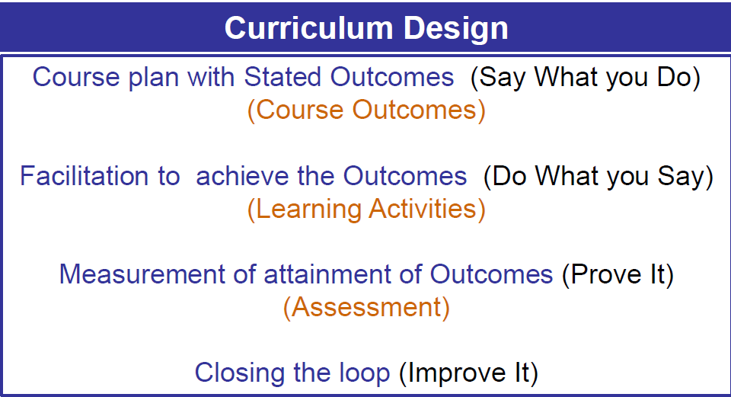
Key Activities in OBE at Course Level

Slide 4
Stakeholders
Regulatory Bodies
Industries / Employers
Society
Advisory Bodies
Management
Alumni
Faculty members
Students & Parents

Slide 5
Characteristics of OBE curriculum
Every learning outcome is intentional and therefore the outcomes must be assessed using suitable performance indicators.
Programme outcomes, which consist of abilities to be attained by students at the time of graduation.
Course outcomes must satisfy the stated programme outcomes.
There is no need for ANY (individual) course to address all programme outcomes.

Slide 6
Developing OBE Curriculum
VISION
Institution Based
PEO
Stakeholder inputs &
requirements
PO
Regulatory body &
Employer expectations
Course Structure / Curriculum
. . . .
Course with course outcomes
Course with course outcomes
Course with course outcomes
Assessment and evaluation for continuous improvement

Slide 7
Program Outcomes (POs)
1. Engineering Knowledge
2. Problem Analysis
3. Design/Development of Solutions
4. Conduct Investigations of Complex Problems
5. Modern Tool Usage:
6. The Engineer and Society
7. Environment and Sustainability
8. Ethics
9. Individual and Team Work
10. Communication
11. Project Management and Finance
12. Life-long Learning

Slide 8
Program Specific Outcomes
1. To identify, analyze and develop software systems using appropriate techniques and concepts related to information technology
2. To design an algorithm or process within realistic constraints to meet the desired needs through analytical, logical and problem-solving skills
3. To apply state of the art IT tools and technologies, IT infrastructure management abilities in treading innovative career path as a prospective IT engineer

Slide 9
Establish the correlation between the Courses and the POs & PSOs
FORMULATION OF COURSE ARTICULATION MATRIX (CAM):
Course Articulation Matrix correlates the individual COs of a course with POs and PSOs. The strength of correlation is indicated as 3 for substantial (high) 2 for correlation, moderate (medium) correlation, and 1 for slight (low) correlation.
FORMULATION OF PROGRAM ARTICULATION MATRIX (PAM):
Program Articulation Matrix is formed by the strength of correlation of COs with POs and PSOs. The strength of correlation is indicated as 3 for substantial (high), 2 for moderate (medium) correlation, and 1 for slight (low) correlation. If course outcomes are attained, the POs correlated to these COs are also attained.

Slide 10
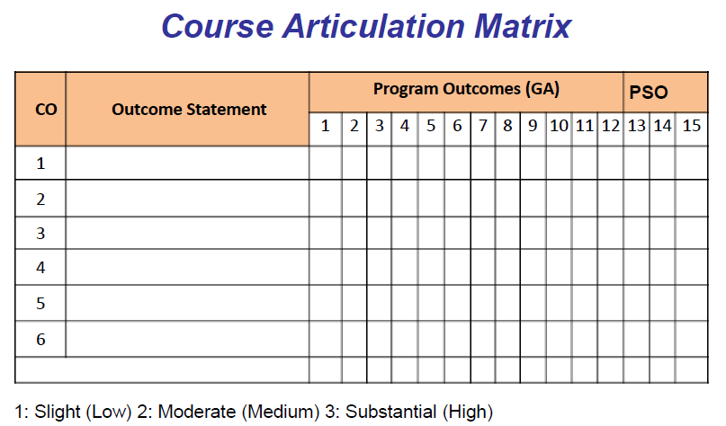

Slide 11
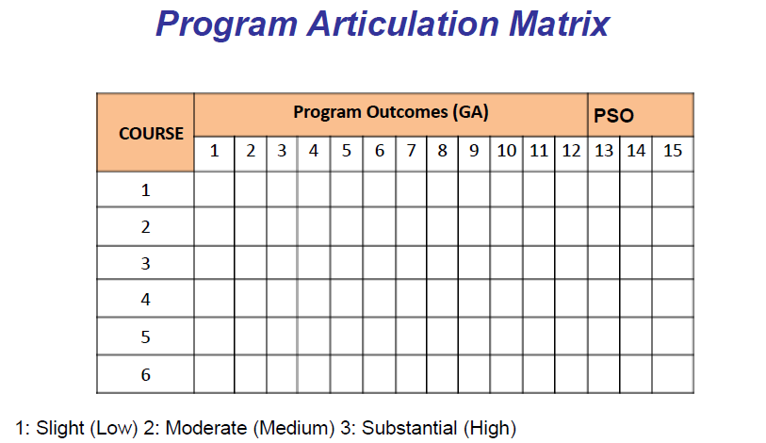

Slide 12
Sample CAM & PAM
SAMPLE COURSE ARTICULATION MATRIX
CO | Statement | PO |  |  |  |  |  |  |  |  |  |  |  | PSO
 |  | 1 | 2 | 3 | 4 | 5 | 6 | 7 | 8 | 9 | 10 | 11 | 12 | 1 | 2 | 3
ICT 2101.1 | Develop simple applications using Java primitives (data types, operators, arrays, variables) | 3 | 3 | 3 | 2 | 3 | 3 | 1 | 1 | 2 | - | 1 | - | 3 | 3 | 1
ICT 2101.2 | Understand how OOP Concepts can be implemented using JAVA | 3 | 3 | 3 | 2 | 3 | 3 | 1 | 1 | 2 | - | 1 | - | 3 | 3 | 2
ICT 2101.3 | Use inbuilt library packages of JAVA | 3 | 3 | 3 | 1 | 3 | 3 | 1 | 1 | 2 | - | 1 | - | 3 | 3 | 3
ICT 2101.4 | Develop Java application using object oriented concepts | 3 | 3 | 3 | 3 | 3 | 3 | 1 | 1 | 2 | - | 1 | - | 3 | 3 | 3
ICT 2101.5 | Write simple concurrent programs using threads | 3 | 3 | 3 | 3 | 3 | 3 | 1 | 1 | 2 | - | 1 | - | 3 | 3 | 3
ICT 2101 |  | 3 | 3 | 3 | 2 | 3 | 3 | 1 | 1 | 2 | - | 1 | - | 3 | 3 | 2
SAMPLE PROGRAM ARTICULATION MATRIX
Course | PO1 | PO2 | PO3 | PO4 | PO5 | PO6 | PO7 | PO8 | PO9 | PO10 | PO11 | PO12 | PSO1 | PSO2 | PSO3
ICT 2101 | 3 | 3 | 3 | 2 | 3 | 3 | 1 | 1 | 2 | - | 1 | - | 3 | 3 | 2

Slide 13
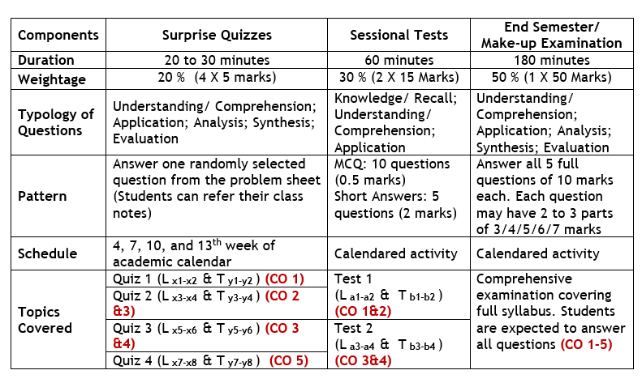
Attainment of Course Outcomes
Typical evaluation procedure for a course with 5 Course Outcomes:

Slide 14
Attainment of Course Outcomes
direct
indirect

Slide 15
Attainment of Course Outcomes
 | Average APG | Attainment Level | Average Pass % | Attainment Level
2016-20 | 7.6 | Good | 99.62 | Excellent
2017-21 | 7.8 | Good | 98.91 | Excellent
2018-22 | 8.0 | Good | 98.69 | Excellent

Slide 16
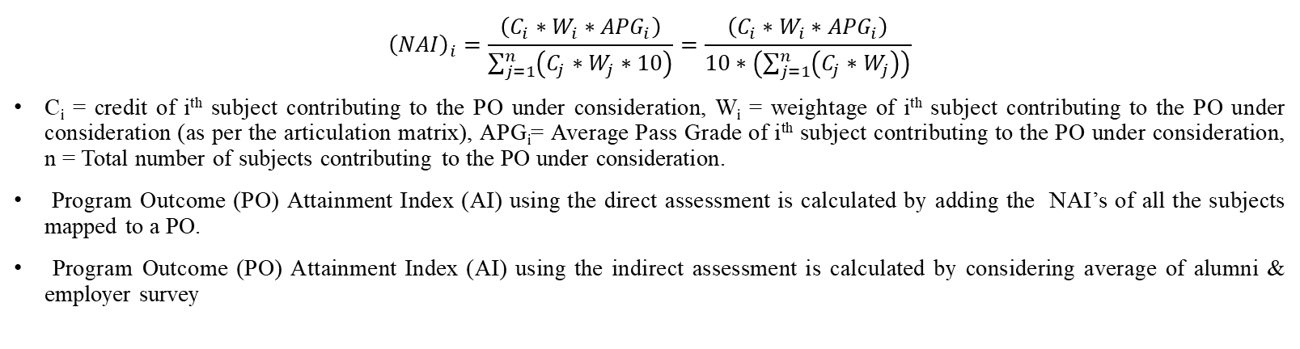
Normalized Attainment Index (NAI)
$${\left(NAI\right)}_{i}=\frac{\left(C_{i}∗W_{i}∗{APG}_{i}\right)}{\sum_{j=1}^{n}{\left(C_{j}∗W_{j}∗10\right)}}=\frac{\left(C_{i}∗W_{i}∗{APG}_{i}\right)}{10∗\left(\sum_{j=1}^{n}{\left(C_{j}∗W_{j}\right)}\right)}$$
C_{i} = credit of i^{th} subject contributing to the PO under consideration, W_{i} = weightage of i^{th} subject contributing to the PO under consideration (as per the articulation matrix), APG_{i}= Average Pass Grade of i^{th} subject contributing to the PO under consideration, n = Total number of subjects contributing to the PO under consideration.
Program Outcome (PO) Attainment Index (AI) using the direct assessment is calculated by adding the NAI’s of all the subjects mapped to a PO.
Program Outcome (PO) Attainment Index (AI) using the indirect assessment is calculated by considering average of alumni & employer survey
PO & PSO Attainment Index (AI) Direct Rubric
Particulars | Excellent | Very Good | Satisfactory | Needs Improvement
PO Attainment | ≥ 0.75 | ≥ 0.7 | ≥ 0.65 | < 0.65
PO & PSO Attainment Index (AI) Indirect Rubric
Particulars | Excellent | Good | Satisfactory | Needs Improvement
PO Attainment | > = 0.70 | > = 0.65 | > = 0.60 | < 0.60

Slide 17
PO Attainment (Direct Assessment)
2016-2020 batch
Analysis of PO attainment (Direct)
PO1 | PO2 | PO3 | PO4 | PO5 | PO6 | PO7 | PO8 | PO9 | PO10 | PO11 | PO12 | PSO1 | PSO2 | PSO3
0.79 | 0.78 | 0.77 | 0.79 | 0.78 | 0.76 | 0.79 | 0.82 | 0.81 | 0.8 | 0.78 | 0.8 | 0.77 | 0.77 | 0.77
Excellent | Excellent | Excellent | Excellent | Excellent | Excellent | Excellent | Excellent | Excellent | Excellent | Excellent | Excellent | Excellent | Excellent | Excellent
2017-2021 batch
Analysis of PO attainment (Direct)
PO1 | PO2 | PO3 | PO4 | PO5 | PO6 | PO7 | PO8 | PO9 | PO10 | PO11 | PO12 | PSO1 | PSO2 | PSO3
0.79 | 0.79 | 0.79 | 0.8 | 0.81 | 0.79 | 0.81 | 0.85 | 0.83 | 0.82 | 0.81 | 0.83 | 0.79 | 0.79 | 0.8
Excellent | Excellent | Excellent | Excellent | Excellent | Excellent | Excellent | Excellent | Excellent | Excellent | Excellent | Excellent | Excellent | Excellent | Excellent
2017-2021 batch
2018-2022 batch
Analysis of PO attainment (Direct)
PO1 | PO2 | PO3 | PO4 | PO5 | PO6 | PO7 | PO8 | PO9 | PO10 | PO11 | PO12 | PSO1 | PSO2 | PSO3
0.82 | 0.82 | 0.83 | 0.84 | 0.85 | 0.81 | 0.85 | 0.85 | 0.84 | 0.86 | 0.89 | 0.85 | 0.82 | 0.82 | 0.85
Excellent | Excellent | Excellent | Excellent | Excellent | Excellent | Excellent | Excellent | Excellent | Excellent | Excellent | Excellent | Excellent | Excellent | Excellent

Slide 18
PO & PSO Attainment (Indirect Assessment)
2016-2020 batch
 | Analysis of PO attainment (Indirect)
 | PO1 | PO2 | PO3 | PO4 | PO5 | PO6 | PO7 | PO8 | PO9 | PO10 | PO11 | PO12 | PSO1 | PSO2 | PSO3
Alumni Survey | 0.79 | 0.78 | 0.74 | 0.75 | 0.70 | 0.73 | 0.73 | 0.80 | 0.81 | 0.82 | 0.73 | 0.77 | 0.78 | 0.79 | 0.77
Employer Survey | 0.89 | 0.84 | 0.80 | 0.82 | 0.84 | 0.80 | 0.75 | 0.91 | 0.91 | 0.95 | 0.75 | 0.84 | 0.82 | 0.82 | 0.87
Average | 0.84 | 0.81 | 0.77 | 0.78 | 0.77 | 0.77 | 0.74 | 0.86 | 0.86 | 0.88 | 0.74 | 0.80 | 0.80 | 0.80 | 0.82
2017-2021 batch
 | Analysis of PO attainment (Indirect)
 | PO1 | PO2 | PO3 | PO4 | PO5 | PO6 | PO7 | PO8 | PO9 | PO10 | PO11 | PO12 | PSO1 | PSO2 | PSO3
Alumni Survey | 0.77 | 0.80 | 0.77 | 0.74 | 0.74 | 0.76 | 0.78 | 0.81 | 0.83 | 0.83 | 0.78 | 0.82 | 0.76 | 0.76 | 0.76
Employer Survey | 0.93 | 0.93 | 0.89 | 0.89 | 0.89 | 0.89 | 0.89 | 0.98 | 0.98 | 0.94 | 0.83 | 0.90 | 0.91 | 0.90 | 0.86
Average | 0.85 | 0.86 | 0.83 | 0.81 | 0.81 | 0.82 | 0.83 | 0.89 | 0.90 | 0.88 | 0.80 | 0.86 | 0.84 | 0.83 | 0.81
2018-2022 batch
 | Analysis of PO attainment (Indirect)
 | PO1 | PO2 | PO3 | PO4 | PO5 | PO6 | PO7 | PO8 | PO9 | PO10 | PO11 | PO12 | PSO1 | PSO2 | PSO3
Alumni Survey | 0.80 | 0.81 | 0.82 | 0.78 | 0.83 | 0.77 | 0.76 | 0.82 | 0.86 | 0.88 | 0.85 | 0.87 | 0.86 | 0.85 | 0.84

Slide 19
Average Attainment Index (Direct)
PO & PSO Attainment
 | PO1 | PO2 | PO3 | PO4 | PO5 | PO6 | PO7 | PO8 | PO9 | PO10 | PO11 | PO12 | PSO1 | PSO2 | PSO3 | Average AI
2016-20 | 0.79 | 0.78 | 0.77 | 0.79 | 0.78 | 0.76 | 0.79 | 0.82 | 0.81 | 0.8 | 0.78 | 0.8 | 0.77 | 0.77 | 0.77 | 0.79
2017-21 | 0.79 | 0.79 | 0.79 | 0.8 | 0.81 | 0.79 | 0.81 | 0.85 | 0.83 | 0.82 | 0.81 | 0.83 | 0.79 | 0.79 | 0.8 | 0.79
2018-22 | 0.82 | 0.82 | 0.83 | 0.84 | 0.85 | 0.81 | 0.85 | 0.85 | 0.84 | 0.86 | 0.89 | 0.85 | 0.82 | 0.82 | 0.85 | 0.81
Average Attainment Index (Indirect)
 | PO1 | PO2 | PO3 | PO4 | PO5 | PO6 | PO7 | PO8 | PO9 | PO10 | PO11 | PO12 | PSO1 | PSO2 | PSO3 | Average AI
2016-20 | 0.84 | 0.81 | 0.77 | 0.78 | 0.77 | 0.77 | 0.74 | 0.86 | 0.86 | 0.88 | 0.74 | 0.8 | 0.8 | 0.8 | 0.82 | 0.80
2017-21 | 0.85 | 0.86 | 0.83 | 0.81 | 0.81 | 0.82 | 0.83 | 0.89 | 0.9 | 0.88 | 0.8 | 0.86 | 0.84 | 0.83 | 0.81 | 0.84
2018-22 | 0.80 | 0.81 | 0.82 | 0.78 | 0.83 | 0.77 | 0.76 | 0.82 | 0.86 | 0.88 | 0.85 | 0.87 | 0.86 | 0.85 | 0.84 | 0.83

Slide 22
Attainment Index (Direct & Indirect)
The final attainment index is computed by using weighted average with 0.8 weight for the direct attainment and 0.2 weight for the indirect attainment.
 | PO1 | PO2 | PO3 | PO4 | PO5 | PO6 | PO7 | PO8 | PO9 | PO10 | PO11 | PO12 | PSO1 | PSO2 | PSO3 | Average AI
2016-20 | 0.80 | 0.79 | 0.77 | 0.79 | 0.78 | 0.76 | 0.78 | 0.83 | 0.82 | 0.82 | 0.77 | 0.80 | 0.78 | 0.78 | 0.78 | 0.79
2017-21 | 0.80 | 0.80 | 0.80 | 0.80 | 0.81 | 0.80 | 0.81 | 0.86 | 0.84 | 0.83 | 0.81 | 0.84 | 0.80 | 0.80 | 0.80 | 0.81
2018-22 | 0.82 | 0.82 | 0.83 | 0.83 | 0.85 | 0.80 | 0.83 | 0.84 | 0.84 | 0.86 | 0.88 | 0.85 | 0.83 | 0.83 | 0.85 | 0.84

Slide 23
Assessment Tools and Rubrics used for PO & PSO Attainment
Assessment tool | Excellent | Very Good | Satisfactory | Needs Improvement
Average AI | ≥ 0.75 | ≥ 0.7 | ≥ 0.65 | < 0.65
Academic Performance (Avg. CGPA) | ≥ 7.25 | ≥ 7 | ≥ 6.75 | < 6.75
Placement % | ≥ 90 | ≥ 80 | ≥ 70 | < 70
% of students graduating in 4 years | ≥ 85 | ≥ 80 | ≥ 75 | < 75
Exit Survey | ≥ 0.8 | ≥ 0.75 | ≥ 0.7 | < 0.7
% of students pursuing higher studies | ≥ 15 | ≥ 10 | ≥ 5 | < 5

Slide 24
Results of Program Attainment using Various Tools
Assessment tool | 2016-20 | Results of attainment of Pos & PSOs as a whole | 2017-21 | Results of attainment of POs & PSOs as a whole | 2018-22 | Results of attainment of Pos & PSOs as a whole
Average AI | 0.79 | Excellent | 0.81 | Excellent | 0.84 | Excellent
Academic Performance (Avg. CGPA) | 7.77 | Excellent | 8.13 | Excellent | 8.24 | Excellent
Placement % | 84.55 | Very Good | 86.36 | Very Good | 84.50 | Very Good
Students graduating in 4 years % | 95.96 | Excellent | 86.57 | Excellent | 87.59 | Excellent
Exit Survey | 0.81 | Excellent | 0.84 | Excellent | 0.82 | Excellent
Students pursuing higher studies (%) | 6.72 | Satisfactory | 7.75 | Satisfactory | 9.48 | Satisfactory

Slide 25
THANK YOU

